Slide 1
How to use the mini-quote system
Schools

Slide 2
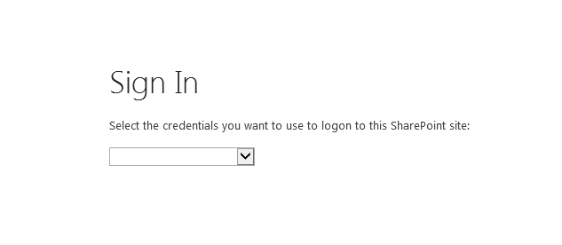
Navigate to: http://webed.ped.state.nm.us/sites/miniquote/mq1 Best experience is in Internet Explorer in compatibility mode At the Login Screen, choose Forms Authentication.

Slide 3
Login with your account information

Slide 4
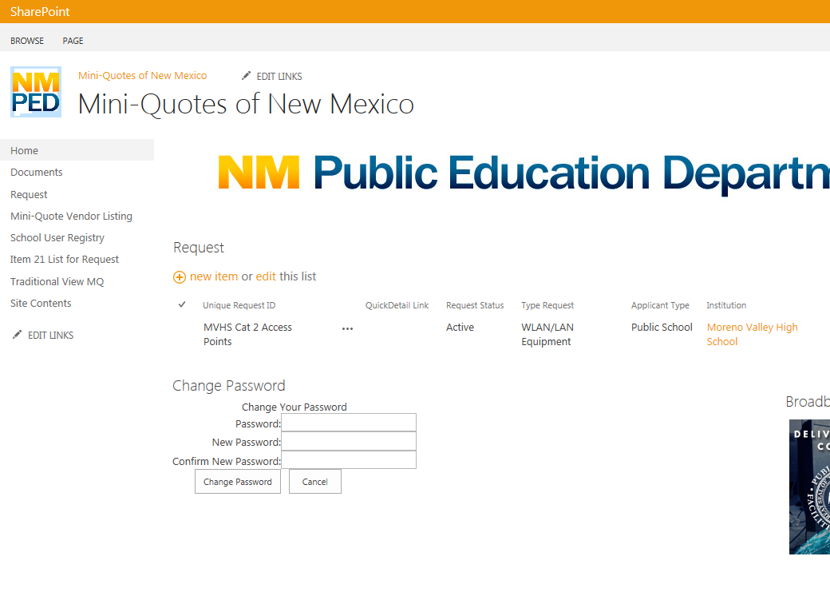
At the home screen, select school user registry

Slide 5
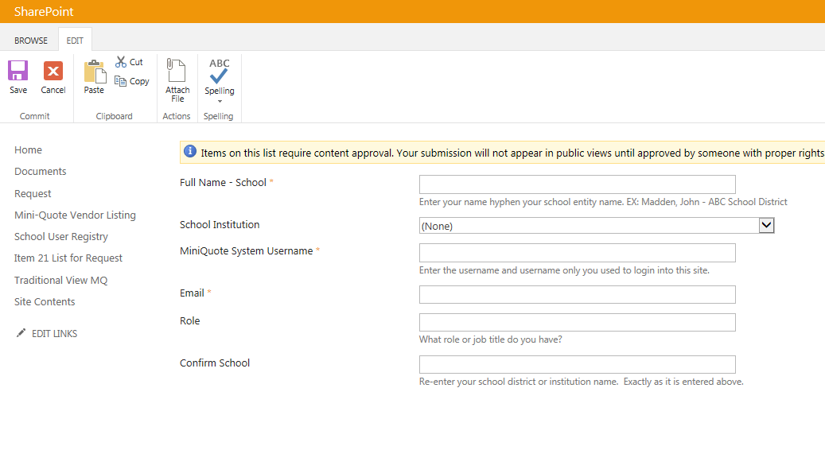
Complete your information in the school user registry. Once you are approved you can submit requests for quotes

Slide 6
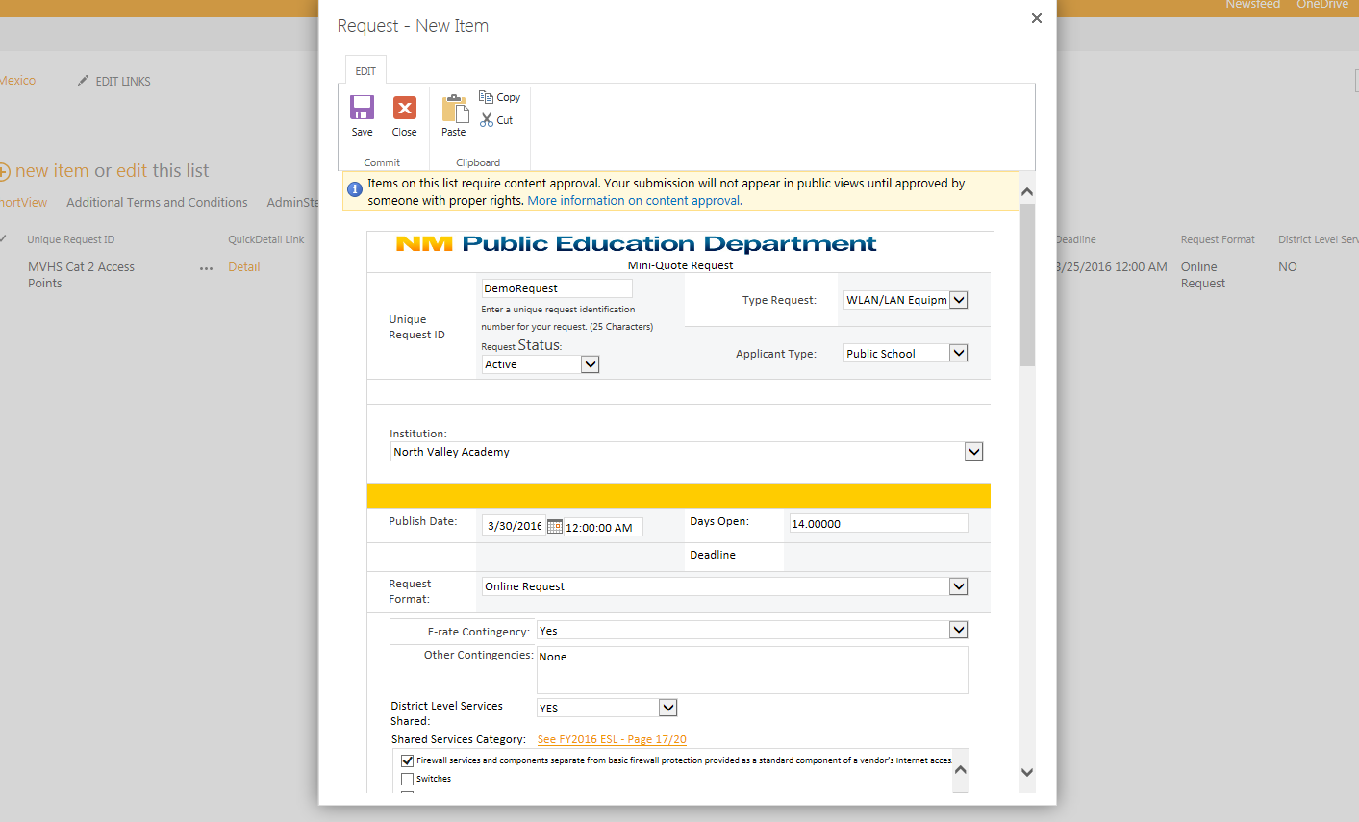
Submit request for quote from home screen by clicking on new item on the requests list. Complete the form and click save. Click on your request in the list and select Alert Me to receive notifications

